Slide 1
Graduation project ML
2022
Mohamed Ismail

Slide 2
Agenda
2022
Data and source
Project goal
Steps

Slide 3
Data and source
2022
Data
Source
Datasets for IT and software engineering companies in India.
Data shape 22770 rows and 8 columns.
Columns:
Rating: rating of the company given by employee
Company name: name of the company
Job title: Employee title
Salary: employee salary (INR)
Salaries reported: No. of times the salary is being reported
Location: location of the company
Employment Status: type of role (Full time, Part time ,..etc)
Job role: role/ field of work.
Data source Kaggel website
Link for data source:
https://www.kaggle.com/datasets/iamsouravbanerjee/software-professional-salaries-2022

Slide 4
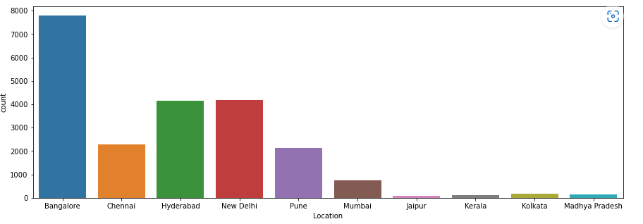
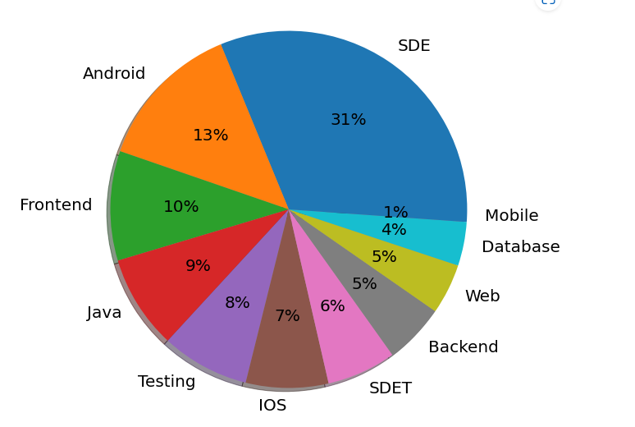
CHART SLIDE
2022
Column chart
Pie chart for Job roles
This column chart represent the number of title for each city
This pie chart represent the percentage of each department

Slide 5
Project Goal
2022
This project support two type of people:
People who search for new vacancy to predict salary for the new vacancy
HR who decide to open new vacancy this app will help him to set salary for this.

Slide 6
THANK YOU!
2022
Mohamed Ismail

